Slide 1
Operating system
We also call the mechanism to overcome this risk as synchronization
Part V: Synchronization risk [1]
Data Inconsistency
By KONG LingBo (孔令波)

Slide 2
Goals
Know the related concepts and definitions
Race conditions, Critical sections, and Atomic operations etc
Know the mechanism of different solutions
Software solutions – algorithms who’s correctness does not rely on any other assumptions.
Peterson’s algorithm
Hardware solutions – rely on some special machine instructions.
TestAndSet(), Swap()
Operating System solutions – provide some functions and data structures to the programmer through system/library calls.
Semaphores
Programming Language solutions – Linguistic constructs provided as part of a language
Monitors
Understand the codes for some classic synchronization problems
Producer-Consumer, Thinking philosophers, Sleeping barbers
Notes:
En

Slide 3
Synchronization
Background & basic concepts
Race conditions, Critical sections, etc.
Problems & Solutions for synchronization
Problems
Producer-Consumer problem, Readers-Writers Problem, The Barbershop Problem, Dining philosopher problem
Tasks
Mutual exclusion, deadlock-free, starvation-free
Solutions
LOCK mechanism is the basis (for mutual exclusion)
PV (Signal-Wait) operations are the first classic prototype
SEMAPHORE/MONITOR (for efficiency & convenience)

Slide 4
Problems with Concurrent Execution
Concurrent processes (or threads) often need to share data (maintained either in shared memory or files) and resources
If there is no proper policy to assign resources among processes, it may result in that all the processes get blocked → Deadlock [死锁]
If there is no controlled access to shared data, execution of the processes on these data can interleave⬅ Cooperation.
The results will then depend on the order in which data were modified→ Data Inconsistency
i.e. the results are non-deterministic.
It always implies “Share resources” at the same time
PPTs from others\flame.cs.dal.ca_~hawkey_3120\May21ProcessSynchronization.ppt

Slide 5


Some functions the designer of OSs should consider carefully
Of course you don’t want this happens when you deposit your money - Synchronization
Resource competition
Data inconsistency is another issue we should consider carefully when competing.
Depositing [存款]
100
100
100
+ 50
+ 100
150
200

Slide 6
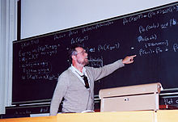
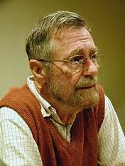
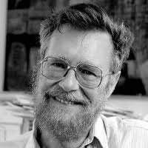
Summarized as Mutual Exclusion [互斥] problem
http://en.wikipedia.org/wiki/Mutual_exclusion
Mutual exclusion, in computer science, refers to the problem of ensuring that no two processes or threads (henceforth referred to only as processes) can be in their code to access the shared data among those processes at the same time
It was formally defined by Edsger Dijkstra in 1965.
Died at
August 6, 2002
(aged 72)

Slide 7
For memorizing: Edsger Dijkstra
http://en.wikipedia.org/wiki/Edsger_W._Dijkstra
Among his contributions to computer science are
the shortest path algorithm, also known as Dijkstra's algorithm;
Reverse Polish Notation and related Shunting yard algorithm;
the THE multiprogramming system, an important early example of structuring a system as a set of layers;
Banker's algorithm;
and the semaphore construct for coordinating multiple processors and programs.

Slide 8
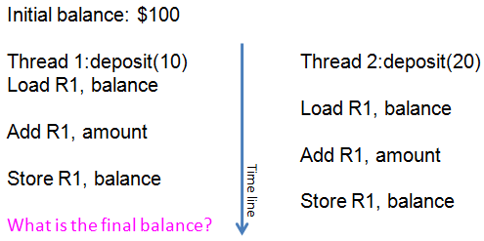
We call that situation as Race Condition
A situation in which multiple threads or processes read and write a shared data item and the final result depends on the relative timing of their execution
A condition in which the value of a shared data item d_{s} resulting from execution of operations a_{i} and a_{j} on ds in interacting processes may be different from both f_{i}( f_{j} (d_{s})) and f_{j} ( f_{i}(d_{s})).
PPTs from others\www.cct.lsu.edu_~kosar_csc4103\08_Process_Synchronization_I_2spp.pdf

Slide 9
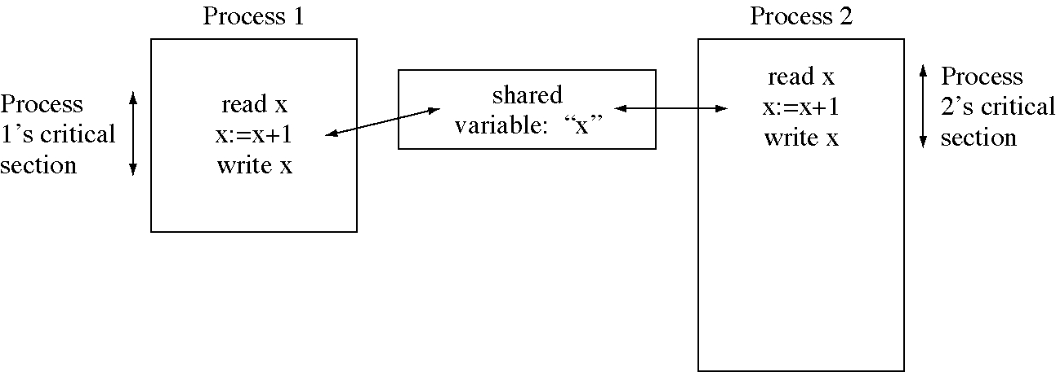
We call those codes as Critical sections
A section of code within a process that requires access shared resources and which may not be executed while another process in a corresponding section of code

Slide 10
classic synchronization models
We investigate the P-C model first
Producer-Consumer model
Readers-Writers Problem
The Barbershop Problem
Dining philosopher problem
Notes:
En 3-19

Slide 11
Producer/Consumer (P/C) Problem
Producer/Consumer is a common paradigm for cooperating processes in OS
Producer process produces information that is consumed by a Consumer process.
Example 1: a print program produces characters that are consumed by a printer.
Example 2: an assembler produces object modules that are consumed by a loader.
Two actions model
Action A:
Create an task, and put it into the waiting zone
Action B:
Select one task from the waiting zone, and serve it
PPTs from others\From Ariel J. Frank\OS381\os4-1_cop.ppt

Slide 12
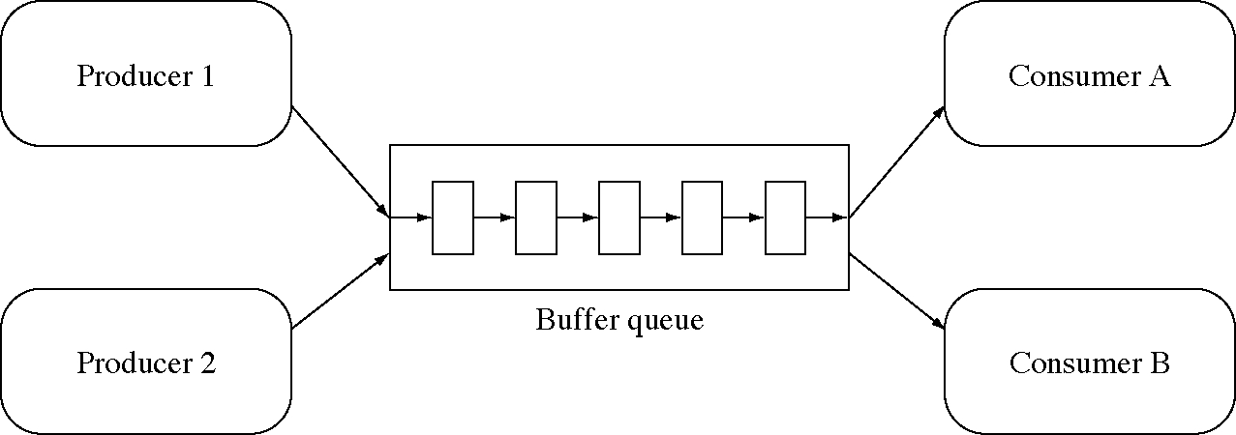
Multiple Producers and Consumers
PPTs from others\From Ariel J. Frank\OS381\os4-1_cop.ppt

Slide 13
To control the execution of critical sections among concurrent processes/threads
The key of synchronization
Ensuring Mutual Exclusion

Slide 14

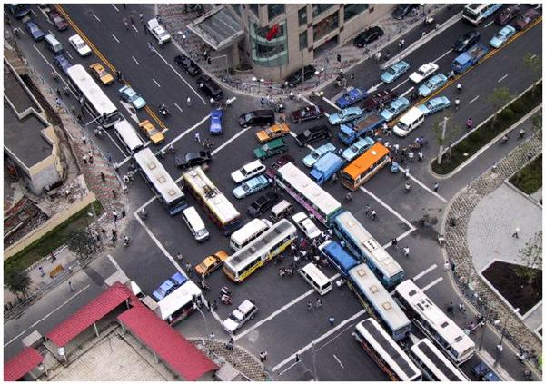
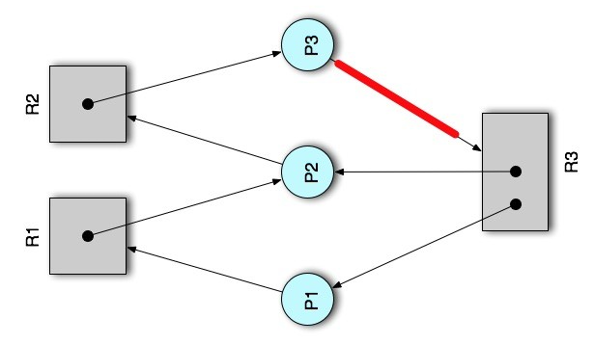

But we also should avoid
For efficiency
Deadlock
None of the involved processes could move further
Starvation
Some process is never executed!
Process/ thread waits indefinitely

Slide 15
Rules for robust synchronization
Of course, Mutual exclusion should be guaranteed (consistency) [互斥]
Only one thread in critical section at a time
Progress (deadlock-free) [有空让进]
If several simultaneous requests, must allow one to proceed
Must not depend on threads outside critical section
Bounded (starvation-free) [有限等待]
Must eventually allow each waiting thread to enter
PPTs.2012\PPTs from others\pages.cs.wisc.edu_~remzi_Classes_537_Fall2005\lecture4.ppt

Slide 16
Synchronization
Background & basic concepts
Multiprogramming/Concurrency + Cooperation
Race conditions, Critical sections, and Atomic operations etc.
Problems & Solutions for synchronization
Problems
Producer-Consumer problem, Readers-Writers Problem, The Barbershop Problem, Dining philosopher problem
Tasks
Mutual exclusion, deadlock-free, starvation-free
Solutions
LOCK mechanism is the basis (for mutual exclusion)
PV (Signal-Wait) operations are the first classic prototype
SEMAPHORE/MONITOR (for efficiency & convenience)

Slide 17
Types of solutions to CS problem
Software solutions –
algorithms who’s correctness does not rely on any other assumptions.
Hardware solutions –
rely on some special machine instructions.
Operating System solutions –
provide some functions and data structures to the programmer through system/library calls.
Programming Language solutions –
Linguistic constructs provided as part of a language.

Slide 18

All are derived from lock mechanism!

Slide 19


Solution to Critical Section Problem using Locks
You also should ensure the “acquire” and “release” are primitive operations.
You just imagine you share the only washing room with the other members of your family ☺
The general layout is of lock solution is: do {
acquire lock
critical section
release lock
remainder section
} while (TRUE);

Slide 20
Software Solutions
We consider first the case of 2 processes:
Peterson’s algorithm is correct.
Then we generalize to n processes:
The Bakery algorithm.
Initial notation:
Only 2 processes, P₀ and P₁
When usually just presenting process P_{i} (Larry, I, i), P_{j} (Jim, J, j) always denotes other process (i != j).

Slide 21
The Critical-Section Problem: 2-Processes: Algorithm N (Peterson 1981)
Interrupt could happen between any two near statements
Process P_{i}
do {
flag [i] = true; turn = j; while (flag [j] and turn = j) ;
critical section
flag [i] = false;
remainder section
} while (1);
Meets all three requirements; solves the critical-section problem for two processes.
PPTs from others\OS PPT in English\ch07.ppt
Notes:
Explain how those 3 requirements are satisfied. [2012-10-12]
ME is obvious
Progress – When the process i executes, it first give the other the chance by “turn =j”. Only if process j does not run can process j run. So once a process enters its CS, other process will always let that process to finish.
Bounded – Every process gets the opportunity, it will not be disturbed, and finish. So all processes can finish in bounded time.

Slide 22
Peterson’s Algorithm: Proof of Correctness
Mutual exclusion holds since:
For both P₀ and P₁ to be in their CS
both flag[0] and flag[1] must be true and turn=0 and turn=1 (at same time) ➔ this is impossible
PPTs from others\flame.cs.dal.ca_~hawkey_3120\May23Synchronization.ppt

Slide 23
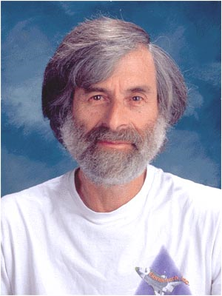
How about for N-processes?
http://en.wikipedia.org/wiki/Leslie_Lamport
Critical section for n processes
We have Bakery algorithm
It is also known as Lamport's bakery algorithm. Lamport?
Dr. Leslie Lamport
I know him because of his work on LaTeX.
You can check some information about LaTeX from my homepage.
You could learn this by yourself and finish a report.
Notes:
zh

Slide 24
Drawbacks of Software Solutions
Even software solutions are very delicate ☺, they are complicated to program ☹
Busy waiting (wasted CPU cycles)
It would be more efficient to block processes that are waiting (just as if they had requested I/O).
This suggests implementing the permission/waiting function in the Operating System → Semaphores & Monitors
In DBMS, the SELF-SPIN LOCK [自旋锁]
Is a kind of BUSY WAITING lock
PPTs from others\flame.cs.dal.ca_~hawkey_3120\May26ConcurrencyCont.ppt

Slide 25
Hardware solutions
Many systems provide hardware support for critical section code.
Uniprocessors – could disable interrupts:
Currently running code would execute without preemption.
Generally too inefficient on multiprocessor systems.
Modern machines provide special atomic (non-interruptible) hardware instructions:
Either test memory word and set value at once.
Or swap contents of two memory words.
PPTs from others\From Ariel J. Frank\OS381\os4-3_cop.ppt
Notes:
25

Slide 26
Hardware Solution ①: Disable Interrupts
Process Pi:
repeat
disable interrupts
critical section
enable interrupts
remainder section
forever
On a uniprocessor, mutual exclusion is preserved : while in CS, nothing else can run
because preemption impossible
On a multiprocessor: mutual exclusion is not achieved
Interrupts are “per-CPU” (interrupts are not disabled on other processors).
Generally not a practical solution for user programs, but could be used inside an OS
PPTs from others\flame.cs.dal.ca_~hawkey_3120\May26ConcurrencyCont.ppt

Slide 27
Hardware Solution ②: Special Machine Instructions
Normally, the memory system restricts access to any particular memory word to one CPU at a time
Useful extension:
machine instructions that perform 2 actions atomically on the same memory location (ex: testing and writing)
The execution of such an instruction is mutually exclusive on that location (even with multiple CPUs)
These instructions can be used to provide mutual exclusion
but need more complex algorithms for satisfying the requirements of progress and bounded waiting
PPTs from others\flame.cs.dal.ca_~hawkey_3120\May26ConcurrencyCont.ppt

Slide 28
Test-and-Set Synchronization Hardware
Test and set (modify) the content of a word atomically (a Boolean version):
boolean TestAndSet(boolean *target) {
boolean rv = *target;
*target = TRUE;
return rv;
}
The Boolean function represents the essence of the corresponding machine instruction.
PPTs from others\From Ariel J. Frank\OS381\os4-3_cop.ppt

Slide 29
Mutual Exclusion with Test-and-Set
Shared data: boolean lock = FALSE;
Process P_{i}
do {
while (TestAndSet(&lock));
critical section
lock = FALSE;
remainder section
}
PPTs from others\From Ariel J. Frank\OS381\os4-3_cop.ppt

Slide 30
Swap Synchronization Hardware
Atomically swap two variables:
void Swap(boolean *a, boolean *b) {
boolean temp = *a;
*a = *b;
*b = temp;
}
The procedure represents the essence of the corresponding machine instruction.
PPTs from others\From Ariel J. Frank\OS381\os4-3_cop.ppt

Slide 31
Machine Instructions for Mutual Exclusion
Advantages
Applicable to any number of processes on either a single processor or multiple processors sharing main memory
It is simple and therefore easy to verify
Disadvantages
Busy-waiting consumes processor time
Starvation is possible when a process leaves a critical section and more than one process is waiting.
Deadlock
If a low priority process has the critical region and a higher priority process needs, the higher priority process will obtain the processor to wait for the critical region
Any idea to overcome these disadvantages?
PPTs from others\OS5e after William Stallings\Chapter05.ppt

Slide 32
从实现原理上来讲，Mutex属于sleep-waiting类型的锁。
例如在一个双核的机器上有两个线程(线程A和线程B)，它们分别运行在Core0和 Core1上。假设线程A想要通过pthread_mutex_lock操作去得到一个临界区的锁，而此时这个锁正被线程B所持有，那么线程A就会被阻塞 (blocking)，Core0 会在此时进行上下文切换(Context Switch)将线程A置于等待队列中，此时Core0就可以运行其他的任务(例如另一个线程C)而不必进行忙等待。
而Spin lock则不然，它属于busy-waiting类型的锁，
如果线程A是使用pthread_spin_lock操作去请求锁，那么线程A就会一直在 Core0上进行忙等待并不停的进行锁请求，直到得到这个锁为止。
http://blog.jobbole.com/107367/
Notes:
[2016年12月17日22:01:08]
数据库中常使用所谓 自旋锁 (Spin lock) 的概念.
http://blog.jobbole.com/107367/

Slide 33


Lock + Manager + Waiting Room
If A tries to use the shared variable, its request will be trapped by the manager, and it’s manager’s responsibility to check if the variable has been occupied or not
If yes, A will be put in waiting room; otherwise, A goes into its CS
After A finishes its job, it should release the lock, and manager will check if there are waiting processes in WR for this lock (resource)

Slide 34
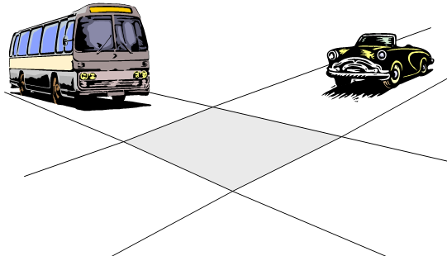
Operating System solutions
Semaphore [信号量]
Software construct that can be used to enforce mutual exclusion
Contains a protected variable
Can be accessed only via wait and signal commands
Also called P and V operations, respectively

Slide 35
Semaphores
A Semaphore S is an integer variable that, apart from initialization, can only be accessed through 2 atomic and mutually exclusive operations:
wait(S)
sometimes called P()
Dutch proberen: “to test”
signal(S)
sometimes called V()
Dutch verhogen: “to increment”
PPTs from others\flame.cs.dal.ca_~hawkey_3120\May26ConcurrencyCont.ppt

Slide 36
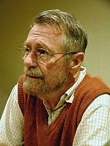
Semaphore & Edsger W. Dijkstra
http://en.wikipedia.org/wiki/Edsger_Dijkstra
http://en.wikipedia.org/wiki/Semaphore_%28programming%29
Invented in the 1965
Basis of all contemporary OS synchronization mechanisms
In computer science, a semaphore is a protected variable or abstract data type that constitutes a classic method of controlling access by several processes to a common resource in a parallel programming environment.
A semaphore generally takes one of two forms: binary and counting.
Either semaphore type may be employed to prevent a race condition.
On the other hand, a semaphore is of no value in preventing resource deadlock, such as the dining philosophers problem.
May 11, 1930 – August 6, 2002
http://en.wikipedia.org/wiki/Dijkstra%27s_algorithm

Slide 37
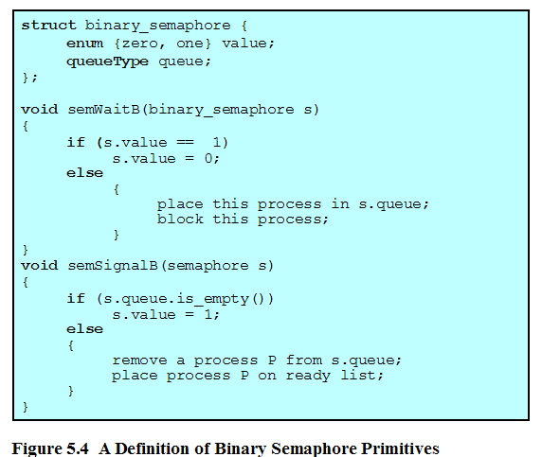
Binary Semaphore Primitives

Slide 38
We can use BS to
Support Mutual Exclusion [MU] for critical section problem of course
Shared data:
semaphore mutex; // initiallized to 1
Process Pi: do { wait(mutex); critical section
signal(mutex); remainder section } while (TRUE);

Slide 39
We can also use BS to
Support ordered execution of two processes (Order Scheduling [SCH])
Execute B in P_{j} only after A executed in P_{i}
Use semaphore flag initialized to 0
Code:
P_{i} P_{j}
 
A wait(flag)
signal(flag) B
P_{j} will wait P_{i} to finish A first, then P_{j} can execute B
Notes:
[2014-03-21 9:54] 明确, SCH 发挥作用也是仅当信号量为0时! 这对于 Counting sema 同样的.

Slide 40
semaphore s1 = 0;
semaphore s2 = 0;
A() { B() {
write(x); P(s1);
V(s1); read(x);
P(s2); write(y);
read(y); V(s2);
} }

Slide 41
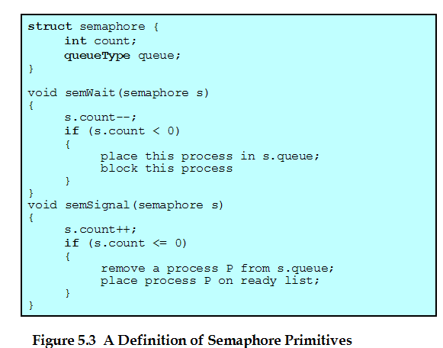
Counting Semaphore
PPTs from others\OS5e after William Stallings\Chapter05.ppt
Notes:
[2015年4月7日19:03:24 逸夫西楼811] 讲课的时候，设计了简单的情况 – 2张桌子，3个学生（A,B,C）来使用。次序如下：
A 先来，那么， 2→1, 但在 CS 前被打断
后是 B, 则 1→0, 但在 CS 前被打断
然后是 C, 0→-1
之后 B 继续并完成 V(), 则 -1→0
然后 C 继续，如果 C 再次执行 P(), 那么，又会将信号量从 0 → -1, 那么，这就不合逻辑！
实际上，应该是 C 再次得到执行时， 是从那个 IF 继续的， 此时，s.count 是 0， 那么， C 可以顺利完成 P()操作。
推测应该是如此， 但是， 实际的实现细节有待考察。
Dijkstra’s P and V
P(s)
s = s-1;
if s < 0 wait (s);
V(s)
s = s+1;
if s ≤ 0 signal(s);

Slide 42
Counting semaphores
Initialized with values larger than one
Can be used to control the competition access to a pool of identical resources
Decrement the semaphore’s counter when taking resource from pool ← wait()
If no resources are available, thread is blocked until a resource becomes available
Increment the semaphore’s counter when returning it to pool → signal()
If there are processes waiting for this type of resources, wake up one of them
Two types of competitions – ME and OrderS

Slide 43
Implementation
A semaphore can be defined as a C struct along these lines:
typedef struct {
int value;
struct process *list;
} semaphore

Slide 44
Implementation
down() operation can be defined as
down(semaphore *S) {
S->value--;
if (S->value < 0) {
add this process to S->list;
block();
}
}
The block() operation suspends the process that invokes it.

Slide 45
Implementation
up() operation can be defined as
up(semaphore *S) {
S->value++;
if (S->value ≤ 0) {
remove process P from S->list;
wakeup(P);
}
}
The wakeup() operation sends a signal that represents an event that the invoking process is no longer in the critical section

Slide 46
Implementation
BTW, the implementation just described is how Linux implements semaphores
The up and down operations represent require access to a critical section which is the semaphore variable
Need hardware/OS support e.g.,
Signals,TSL
Signals allow for a “message” to be sent to processes

Slide 47

Detailed example for CS problem

Slide 48


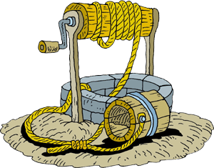
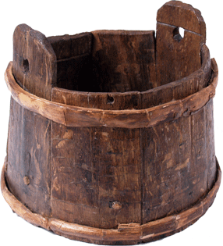
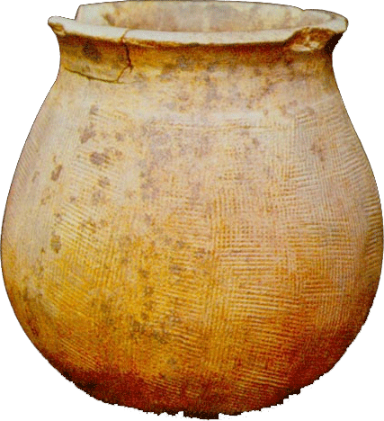
A story: monks drink water
Many monks
Some are old
Some are young
One well
Only one bucket in well every time
One Vat
Can contain 10 buckets of water
One bucket to put water into and fetch water from the vat
Three buckets in total
Notes:
The young monks are in charge of fetching water from the well into vat with the buckets .
The old monks just drink water with buckets from the vat.

Slide 49
General rules to cope with CS problem using semaphores
Find the types of actors
To determine the processes
Recognize the shared resources between actors → initial values of semaphores
Infer the constraints based on the situations when actors use those shared resources
ME or SCH?
To determine semaphores and their initial values
To determine the code (nested for ME, and scattered for SCH)
Use semaphores to finish those processes

Slide 50
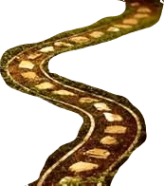
Good habits: write down the detailed steps of the actors to carry out the story, especially clarifying the constraints they should obey
LOGICALLY CORRECT
Attention：they have to compete the shared resources!!
How about the young?
How about the old?
Notes:
Long ago there are many monks in a temple. Some were old and some were young. The young monks were bringing up water from a well. And the old monks can regale on it.
The well was too small to put one bucket every time.
Another vat [大桶] is in the kitchen. It can contain total 10 buckets water. Only one bucket can put in vat and fetch out water.
There are 3 buckets can be used by everyone.

Slide 51
In our story
Find the types of actors
Two types actors (processes): young monks and old monks
The young picks a bucket, goes to the well to fetch water and puts the water into the vat
The old picks a bucket to get water from the vat
Recognize the shared resources between actors
Three types of shared resources:
Vat: among all monks
Well: among young monks
3 buckets: among all monks (because all monks should get one bucket to pick water from the well or vat)

Slide 52
In our story (cont’)
Infer the constraints based on the situations when actors use those shared resources (ME or SCH?) – checking SCH is always first!
Conclude the action scripts
For young:
Check if the vat could contain more buckets of water. No, no more action – wait the old to consume the water (at first, the vat could contain 10 buckets of water →SCH for the young).
Compete a bucket (→ ME: share buckets with other monks)
Go to the well and get a bucket of water from the well (→ ME of well: only one bucket could access the well every time)
Try to pour the bucket of water back to vat (→ ME of vat: )
Release the bucket
Inform the old that they could consume the water (←SCH: for the old: initially, the vat has 0 bucket of water) .
Two SCH situations here: full and empty of vat, which means there should be two SCH semaphores!
Keep this in mind: SCH is only valid when the semaphore’s value is 0

Slide 53
In our story (cont’)
Infer the constraints based on the situations when actors use those shared resources (ME or SCH?) – checking SCH is always first!
Conclude the action scripts
For old:
Check if the vat contains water or not (→SCH: for the old: initially, the vat has 0 bucket of water)
Compete a bucket (→ ME: share buckets with other monks)
Try to fetch a bucket of water from the vat (ME of vat: )
Release the bucket
Inform the young because the vat now could contain one more bucket of water (←SCH: for the young. at first, the vat could contain 10 buckets of water)
Two SCH situations here: full and empty of vat, which means there should be two SCH semaphores!
Keep this in mind: SCH is only valid when the semaphore’s value is 0

Slide 54
In our story (cont’)
Use semaphores to finish those processes
Binary semaphores for ME: Well, vat
Counting semaphore: idleBuckets (=3) for ME, VatCouldContain (= 10), WaterInVat (= 0) for SCH
For young:
when VatCouldContain =0, the young should not compete the buckets;
Once a young gets a bucket, he should finish 2 steps wholly: fetch a bucket of water and put that water into the vat
Once he finishes, the occupied bucket will be released and the WaterInVat will be incremented
For old:
when WaterInVat=0, the old should not compete the buckets
Once an old get a bucket, he drinks that water, releases that bucket and decremented the VatCouldContain

Slide 55
For the young:
P(VatCouldContain) // initial = 10
P(idleBuckets); // initial = 3
P(well);
// get a bucket of water
V(well);
P(vat);
// put the water into the vat
V(vat);
V(idleBuckets);
V(WaterInVat); // initial = 0

Slide 56
For the old:
P(WasterInVat) // initial = 0
P(idleBuckets); // initial = 3
P(vat);
// get a bucket and drink the water
V(vat);
V(idleBuckets);
V(VatCouldContain); // initial = 10

Slide 57
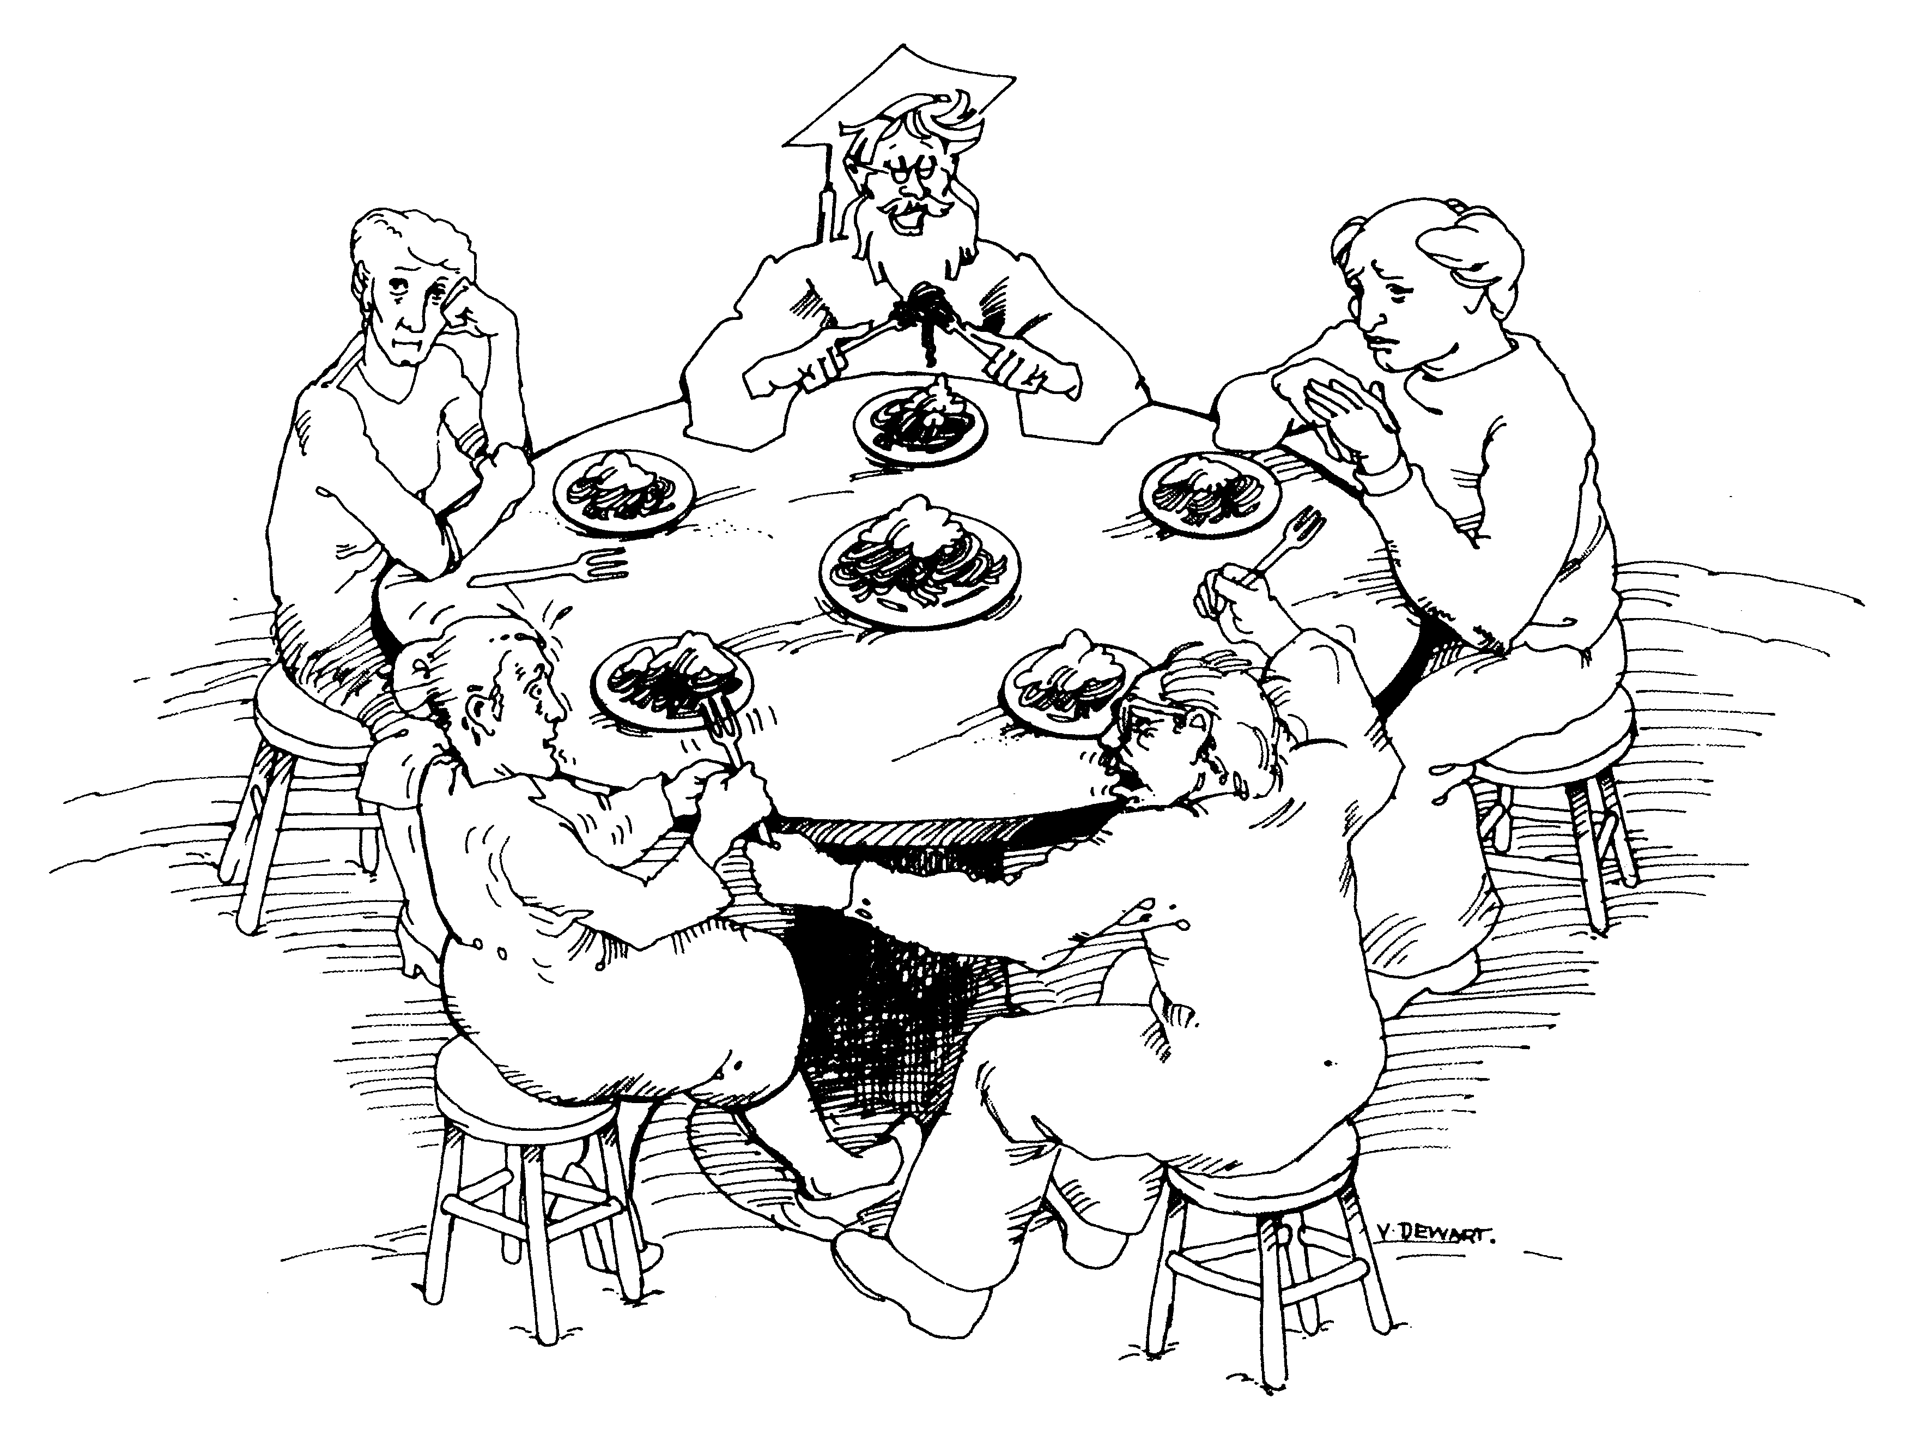
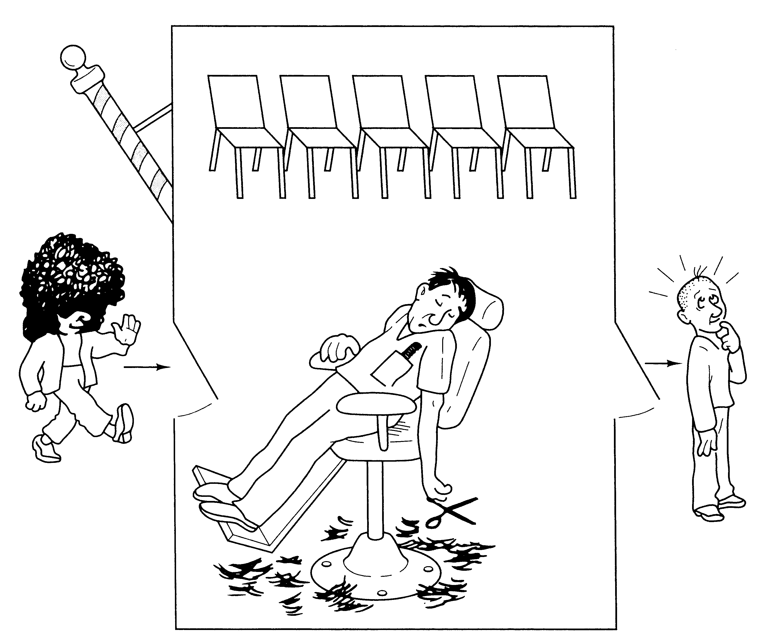
CLASSICAL PROBLEMS OF SYNCHRONIZATION
Your turn to read and understand these classic CS problems!
Bounded-buffer problem
(有限缓存问题)
Readers-writers problem
(读者-著者问题)
Dining-philosophers problem
(哲学家就餐问题)
Barbershop problem
(理发师问题)
PPTs from others\OS PPT in English\ch07.ppt

Slide 58
Be careful: Deadlock and Starvation
Deadlock – two or more processes are waiting indefinitely for an event that can be caused by only one of waiting processes.
Let S and Q be two semaphores initialized to 1
P₀ P₁
wait(S); wait(Q);
wait(Q); wait(S);
 
signal(S); signal(Q);
signal(Q) signal(S);
Starvation – indefinite blocking. A process may never be removed from the semaphore queue (say, if LIFO) in which it is suspended.
Priority Inversion – scheduling problem when lower-priority process holds a lock needed by higher-priority process

Slide 59
Programming Language solutions: Monitors
Monitor: Hide Mutual Exclusion
No need for users to explicitly call the related functions
Declare a monitor which hide the details of synchronization, and provide friendly interface
Only one process may be active within the monitor at a time.
Found in many concurrent programming languages:
Concurrent Pascal, Modula-3, C++, Java...
Can also be implemented by semaphores.

Slide 60
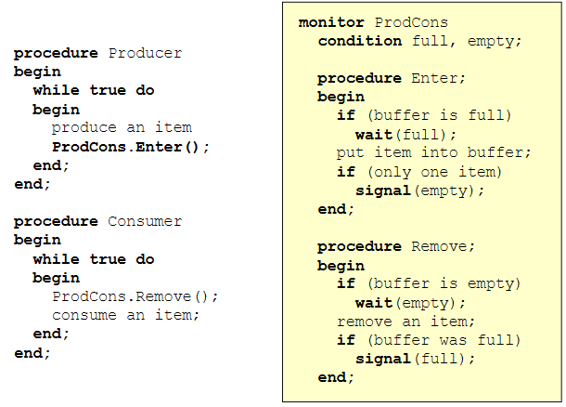
Notes:
https://www.cs.princeton.edu/courses/archive/fall11/cos318/lectures/L8_SemaphoreMonitor_v2.pdf

Slide 61
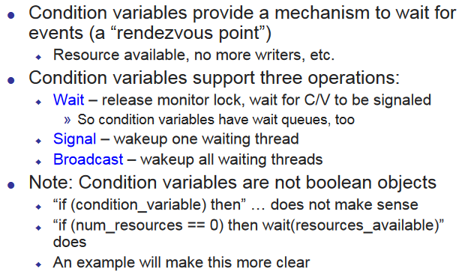
Condition variable != Semaphore

Slide 62
Monitors in Java
Every object of a class that has a synchronized method has a monitor associated with it
Any such method is guaranteed by the Java Virtual Machine execution model to execute mutually exclusively from any other synchronized methods for that object
Access to individual objects such as arrays can also be synchronized
also complete class definitions
One condition variable per monitor
wait() releases a lock, i.e, enters holding area
notify() signals a process to be allowed to continue
notifyAll() allows all waiting processes to continue
PPTs.2012\PPTs from others\www.dcs.ed.ac.uk_teaching_cs3_os_slides\monitor.ppt

Slide 63
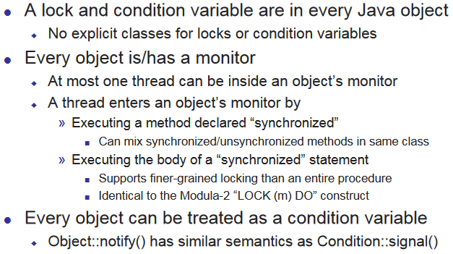
Monitors in Java

Slide 64
example:
class DataBase { public synchronized void write ( . . . ) { . . . } public synchronized read ( . . . ) { . . . } public void getVersion() { . . . } }
once a thread enters either of the read or write methods, JVM ensures that the other is not concurrently entered for the same object
getVersion could be entered by another thread since not synchronized
code could still access a database safely by locking the call rather than by using synchronized methods:
DataBase db = new DataBase(); synchronized(db) { db.write( . . . ); }
PPTs.2012\PPTs from others\www.dcs.ed.ac.uk_teaching_cs3_os_slides\monitor.ppt

Slide 65
Monitor as a Mini-OS
The concept of a monitor is very similar to an operating system.
One can consider the initialization as those data that are initialized when the system is booted up, the private data and code as the internal data structures and functions of an operating system, and the monitor procedures as the system calls.
User programs are, of course, threads that make service requests.
Therefore, a monitor can be considered a mini-OS with limited services.
Notes:
https://www.cs.mtu.edu/~shene/NSF-3/e-Book/MONITOR/basics.html
[2016年3月22日14:42:14]

